Slide 1

Differential Cryptanalysis of the DES S1 Substitution Box
William A. Davis
Laxima N. Kandel Embry-Riddle Aeronautical University
Daytona Beach, FL, USA
Notes:
The goal of the project was to study how differences propagate through the S1 S-Box and to measure statistical biases that appear in its output. These biases are the foundation of differential cryptanalysis.

Slide 2

What Differential Cryptanalysis Does
Tracks how ΔX(input differences) create ΔY(output differences)
Chosen-plaintext attack model
Looks for predictable, non-uniform patterns
More bias = easier to attack reduced-round ciphers
Notes:
Differential cryptanalysis studies how differences at the input of a cipher produce differences at the output. If certain output differences happen more often, that bias can be used to recover key bits.

Slide 3

Why DES Is a Good Candidate
DES relies heavily on 8 S-boxes
S-boxes aren’t perfectly uniform
Some transitions occur with higher probability
These biases are attackable in reduced-round DES
Notes:
DES was designed in the 70s. Even though it’s still structured, its S-boxes leak measurable differential information.

Slide 4

Project Goal
Analyze the DES S1 S-box specifically
Measure output differences for two fixed ΔX values
Use 20,000 randomized trials per difference
Compare empirical frequencies to theory
Notes:
I focused only on S1 so I could remove the complexity of all 16 DES rounds and zoom in on the nonlinear core.

Slide 5

Understanding the S1 S-Box
6-bit input → 4-bit output
Outer bits choose row
Middle 4 bits choose column
Behavior defined by a fixed lookup table
Notes:
S1 takes six input bits, derives a row from the outside bits and a column from the inner four. That output is the nonlinear part that makes DES complex.

Slide 6

Input Differences Used
ΔX = 1 (binary: 000001)
ΔX = 2 (binary: 000010)
Small, controlled bit changes
Still trigger measurable nonlinear responses
Notes:
These tiny differences let us see how sensitive the S-box is to single-bit flips.

Slide 7

Python Automation Overview
Generate random X
Create X’ = X XOR ΔX
Apply S1 to both inputs
Compute ΔY = Y XOR Y’
Repeat 20,000 times per ΔX
Notes:
The script repeatedly creates controlled input pairs, runs them through S1, and logs the differences.

Slide 8

Code Logic (Part 1)
Store S1 table as a 4×16 nested list
Extract row: use bit0 + bit5
Extract column: bits 1–4
Lookup 4-bit output value
Notes:
This portion handles replicating S1 exactly. Any mismatch breaks the experiment.

Slide 9

Code Logic (Part 2)
Use Python’s randint for random inputs
XOR ensures controlled ΔX differences
Frequency dictionary stores ΔY counts
Ensures repeatable and consistent results
Notes:
The automation removes human error. The bias becomes statistically obvious after a few thousand iterations.

Slide 10

Results: ΔX = 1
Most common ΔY values:10 (~0.185)
9 (~0.156)
12 (~0.155)
Uniform random expectation = 0.0625
Notes:
For ΔX=1, these three differences dominate, appearing two to three times more often than chance.

Slide 11

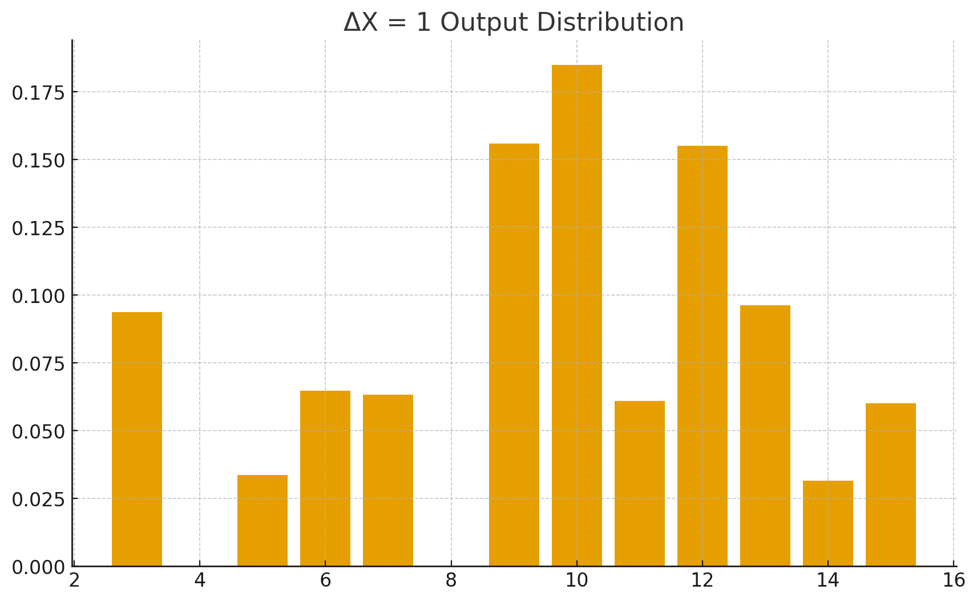
ΔX = 1 Results
Strong peaks at ΔY = 10, 9, 12
Probabilities ~0.15–0.19
Expected uniform = 0.0625
Highly biased output distribution
Notes:
The ΔX=1 experiment clearly shows bias. The strongest outputs occur almost triple uniform expectation…

Slide 12

ΔX = 1 Output Distribution Chart
Strong peaks at ΔY = 10, 9, 12
Non-uniform distribution
Reproducible across runs
Notes:
You can visually see the bias. If S1 were random, the bars would be flat. They aren’t.

Slide 13

Results: ΔX = 2
Dominant ΔY:12 (~0.186)
Mid-level ΔY values:10, 3, 11, 9
Still far from uniform distribution
Notes:
For ΔX=2, ΔY=12 dominates all other differences. This is a stronger bias than the ΔX=1 result.

Slide 14

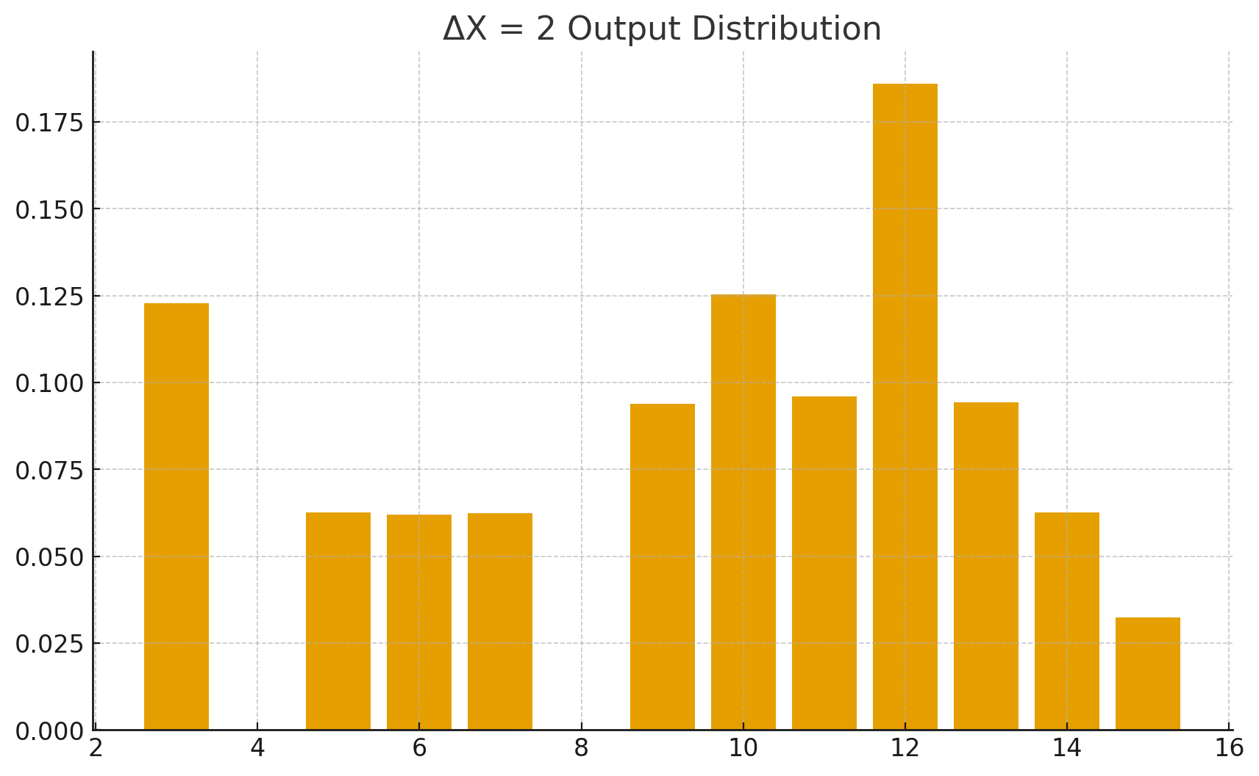
ΔX = 2 Results
Dominant ΔY = 12 (~0.186)
Strong mid‑tier outputs at 10, 3, 11, 9
Bias even sharper than ΔX=1
Consistent across trials
Notes:
ΔX=2 reveals the strongest bias in the entire analysis…

Slide 15

ΔX = 2 Output Distribution Chart
Massive spike at ΔY = 12
Mid-range cluster of values
Confirms strong structural patterns
Notes:
This spike is exactly what differential analysts exploit when chaining multiple S-box transitions.

Slide 16

Comparing ΔX=1 vs ΔX=2
Both show strong nonuniformity
ΔX=2 produces sharper, more exploitable peaks
Input choice matters in cryptanalysis
Reveals structural weaknesses in S1
Notes:
What input difference you choose drastically affects how ‘loud’ the S-box leaks become.

Slide 17

Key-Space Reduction Demonstration
Strongest bias: ΔX = 2 → ΔY = 12
Generate pairs that follow the biased transition
Test all 64 possible 6-bit S1 subkeys
Score each key by how many pairs it explains
True key ranks at the top (80/80 matches)
Differential bias dramatically shrinks key search space
Notes:
Using the strongest bias ΔX = 2 → ΔY = 12, I scored all 64 S1 subkeys, and the real key ranked at the top, showing how differential bias quickly narrows the key space.

Slide 18

Cryptanalytic Importance
Predictable ΔY reduces brute-force search space
In reduced-round DES, this gives a real advantage
DES S-box leakage is well known
Modern ciphers harden S-boxes to avoid this
Notes:
This is why DES got replaced. Modern S-boxes like AES use algebraic constructs to flatten differential output distributions.

Slide 19

Educational Value of the Experiment
Easy to implement in Python
Reveals nonlinear behavior with clarity
Demonstrates real cryptanalytic principles
Helps build intuition about S-box behavior
Notes:
Doing this experiment on one isolated S-box teaches more than jumping straight into the full 16-round DES.

Slide 20
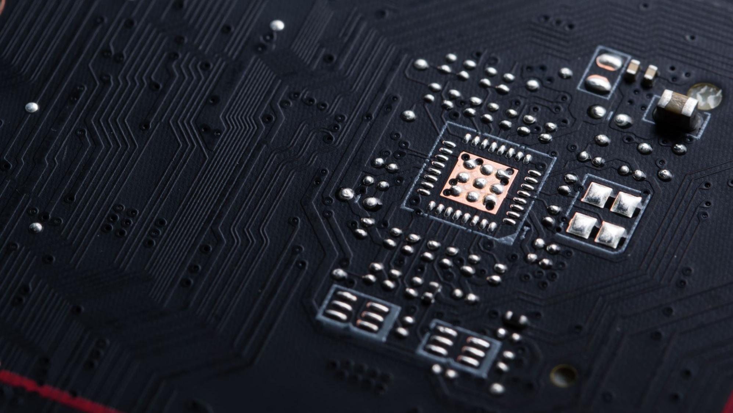
Conclusion
Python experiment matches known DES characteristics
S1 shows clear, reproducible differential bias
ΔX=1 and ΔX=2 both produce predictable ΔY patterns
Confirms structural weakness in early cipher design
Notes:
In summary, the experiment replicates known differential cryptanalysis results and clearly shows why DES is vulnerable in reduced-round contexts.

Slide 21

Questions
Thank you
Any questions?
Notes:
I’m happy to go into more detail on the methodology, the code, or the cryptanalytic significance. A lot of this comes down to how differences propagate through nonlinear functions. The S-box structure determines those probabilities.

